Slide 1

Module – 10
Hibernate

Slide 2
Introduction to Hibernate
Hibernate is an ORM Tool (Object Relationship Mapping).
Hibernate is a framework.
Hibernate is free. Developer need not buy this software.
Hibernate generates the SQL automatically. User need not write the SQL.
Hibernate reduces the development time.

Slide 3
Why not JDBC.
It is very difficult to manage with JDBC for large projects.
JDBC does not support Object Oriented concepts like encapsulation and Inheritance.
It is difficult to implement MVC architecture with JDBC.
Queries are based on database not based on the current project.

Slide 4
Hibernate - ORM.
Business objects can directly access data objects rather than tables. Helpful in DAO and DTO patterns.
SQL query is generated by ORM, hence SQL Query is hidden.
Hibernate is developed on top of JDBC.
Need not write DB specific queries.
Transaction Management like Commit() and Rollback() are automatically taken care.
Time consumption is less when compared to JDBC.

Slide 5
Hibernate
Pls have a picture here..
This picture has 2 rectangles and 1 db icon.
. 1 rectange has Java application as text.
2nd rectange contains Hibernate as text
3rd is Databse icon.
Bi-directional arrays from 1st rectange to 2nd and to the DB ICON.
I want to convey that data flows between java application to hibernate and from hibernate to Databse and vice versa.

Slide 6
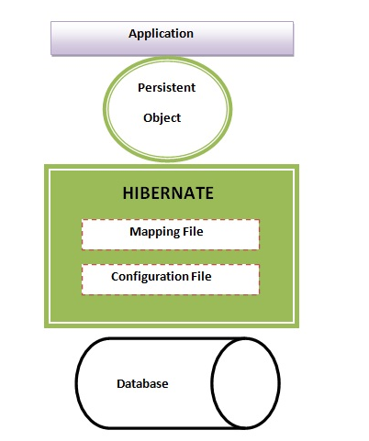
Hibernate Architecture.
Pls make similar picture of this..

Slide 7
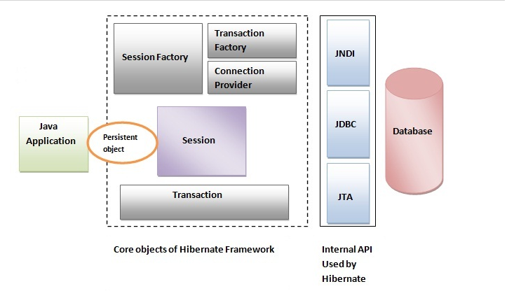
Hibernate Architecture.
Pls make similar picture.

Slide 8
Hibernate Architecture...
SessionFactory creates session.
Session is an interface which connects between the application and data stored in the databse. Session provides methods to Insert, update and delete data in database.
Transaction allows the application to define the units of work.
ConnectiionProvider is a strategy for obtaining JDBC connections. The ConnectionProvider interface is not intended to be exposed to the application. Instead it is used internally by Hibernate to obtain connections.

Slide 9
Files required in Hibernate
Hibernate configuration file → hibernate.cfg.xml → This file will have database connection parameter.
Java object which needs to be written in the db. This is a bean class. This is a
Hibernate mapping file → .hbm file. → This file will map the bean class with database.
Client class → This class is to test the hibernate application.

Slide 10
Hibernate.cfg.xml
<hibernate-configuration>
<session-factory>
<property name="hibernate.connection.driver_class">oracle.jdbc.driver.OracleDriver</property>
<property name="hibernate.connection.url">jdbc:oracle:thin:@charan-HP:1521:XE</property>
<property name="hibernate.connection.username">userid</property>
<property name="connection.password">password</property>
<property name="hibernate.dialect">org.hibernate.dialect.Oracle9Dialect</property>
<property name="show_sql">false</property>
<mapping resource="employee.hbm.xml"/>
</session-factory>
</hibernate-configuration>a

Slide 11
Hibernate.cfg.xml
This is hibernae configuration file.
This file will have Database configuration parameters like (a) Driver class (b) Connection URL (c) User name, Pass word.
Dialect is the one while converts the hibernate statements into its corresponding SQL queries of the database.
show_sql --> will display the generated sql in output console window.
Mapping resource --> will speicify the mapping file which maps between class and db table.

Slide 12
Persistent class.
A class which has the fields to be mapped with the database.
This class has constructor with arguments.
Getter and Setter methods for all the attributes of the class.
Please write two rectanges here..
Employee.java employee table in db.
Id id
Firstname first_name
Lastname last_name
Salaray salary
Here I want to show one to one mapping of the fields between class and employee table. Show the arrows which shows that they are mapped one to one.

Slide 13
Hbm file..
Hbm file stands for Hibernate mapping.
This file maps between persistent class and table. All the fields are mapped one to one.
<hibernate-mapping>
<class name="Employee" table="EMPLOYEE">
<id name="id" type="int" column="id"> </id>
<property name="firstName" column="first_name" type="string"/>
<property name="salary" column="salary" type="int"/>
</class>
</hibernate-mapping>
This file maps Employee class with EMPLOYEE table. Class attributes Id, firstname and salary are mapped with its columns of the EMPLOYEE table respectively.

Slide 14
Client program.
Connecting with the db.
Configuration conf = new Configuration().configure();
StandardServiceRegistryBuilder builder= new StandardServiceRegistryBuilder().applySettings(conf.getProperties());
factory= conf.buildSessionFactory(builder.build());
configuration object configure() uses the mappings and properties specified in the hibernate.cfg.xml.
ServiceRegistry is used to load the list of services in the hibernate.cfg.xml. Apart from settings, some services to be exeucted also can be provided in the configuration file.
Using these services build the sessionFactory so that openSession of Session will connect to the database for transactions.

Slide 15
For Add/list/update/delete
Following session methods are used to perform add/update/delete/list records of the database.
Save (object) --> Saves the object in the database.
createQuery("FROM Employee").list() --> gets the result of Select * from Employee and returns it in a collection List.
Update() --> is used to udpate a record in the database.
Delete() --> is used to delete a record from the table.

Slide 16
Criteria and Restrictions.
Criteria is an interface to query on a particular persistent class.
Session has CreateCriteria() method which returns a Criteria object of a particular class to fire the query on.
Where clause of SQL can be added by using conditional methods of Restrictions class. This can be added by add() method of Criteria class. For example:
  Criteria c = new Criteria (Employee.class);
  c.add (Restritctions.gt (“salary”, 5000));
  List lst = cr.list();
The above 3 lines create a criteria object c. With add() method of Criteria object a condition is added as salary is > 5000. list() method of Criteria object returns the result set in collection list.
Trainer needs to demonstrate this program to the student

Slide 17
..Mapping in hibernate.
There are 3 types of relationship mappings in database/hibernate. They are.
(a) One to One --> Example : One student has one Teacher.
(b) One to Many --> Example : One Organization has many employees.
(c) Many to Many --> Example : Many employees has many certificates.

Slide 18
Relationship mapping pictures..
Pls add these image here...
http://docs.oracle.com/cd/E14571_01/web.1111/b32441/img/onetoone_map_fig.gif
Many to one...
http://2.bp.blogspot.com/-QyLSI1zqdLA/T56sonkqKRI/AAAAAAAAA5Y/W7A3jq0-I78/s1600/many-to-one.jpg
Many to Many --> Pls place icons for Employees and Projects rather than ellipses.
http://www.expertsmind.com/CMSImages/411_Mapping%20cardinality-Many-to-Many.png

Slide 19
One to One relationship mapping.
Here two persistent classes are required to connect.
For example, An employee having an adress. Here Employee is a persistent class and Address is another.
There is one to one mapping between Employee and Address class/tables.
In the hbm file both the classes and their corresponding tables has to be mentioned. Attributes of class and Fields of the tables has to be mapped accordingly.
One extra paramter <one-to-one> or <Many-to-one with unique=”true”> can be used to have one to one relationship.
Trainer : Please demonstrate this to the student.

Slide 20
Many to One and Many to Many.
<Many-to-One> attribute has to be used in hbm file for many to one relationship mapping.
<many-to-many> attribute has to be used in hbm file for many to many relationship mapping.
Trainer to demonstrate these programs to students.

Slide 21
Inheritance in Hibernate.
In hibernate, inheritance classes can be mapped with databse tables. One of the type of inheritance in Hibernate is Table per hierachy.
Table per hierarchy – Only one table is required for the entire hierarchy.
For implementing inheritance, define the base class and derived classes with its attributes.
In the hbm file, use the base class as the class parameter and derived classes as subclass under base class. Syntax is given as below.

Slide 22
Inheritance in hibernate
<hibernate-mapping>
<class name="Student" table="stu121" discriminator-value="stu">
<id name="id">
<generator class="increment"></generator>
</id>
<discriminator column="type" type="string"></discriminator>
<property name="name"></property>
<subclass name="Regular_Student" discriminator-value="reg_stu">
<property name="college_address"></property>
</subclass>
<subclass name="Correspondance_student" discriminator-value="corr_stu">
<property name="house_address"></property>
</subclass>
</class>
</hibernate-mapping>

Slide 23
Caching in hibernate
Question : What is Caching and why do we need it / what is the advantage of caching..
Answer : Storing the data in memory rather than querying again and again with the database will improve the performance of the system.
There are 3 levels of caching in hibernate.
First level cache – Session object provides the first level caching. Deveoper need not do anything for this. Hibernate provides this caching by default. Once the session is closed, the cached data will be lost.

Slide 24
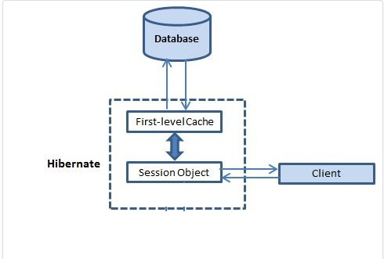
First level cache.
Pls make the image similar to this...

Slide 25
Second level cache.
Second level cache is build using SessionFactory.
Cache parameter has to be used in hbm file for caching the class.
Include <cache usage="read-write"/> in the hbm file to cache the specified class.

Slide 26
Query Cache.
Query results can be cached using Query Cache in hibernate.
To use the query cache, parameter hibernate.cache.use_query_cache shoudl be set to true in configuration file.
Use setCacheable(true) in the code to cache the query results.

Slide 27
Preparation for the next module: Please go through the XML module we have covered and Object Oriented concepts

Slide 28
Thank you!

